Slide 1
EL Image Processing (Enhanced)
User Guide
Dinh Khoat Hoang Anh

Slide 2
01
Algorithm Overview

Slide 3
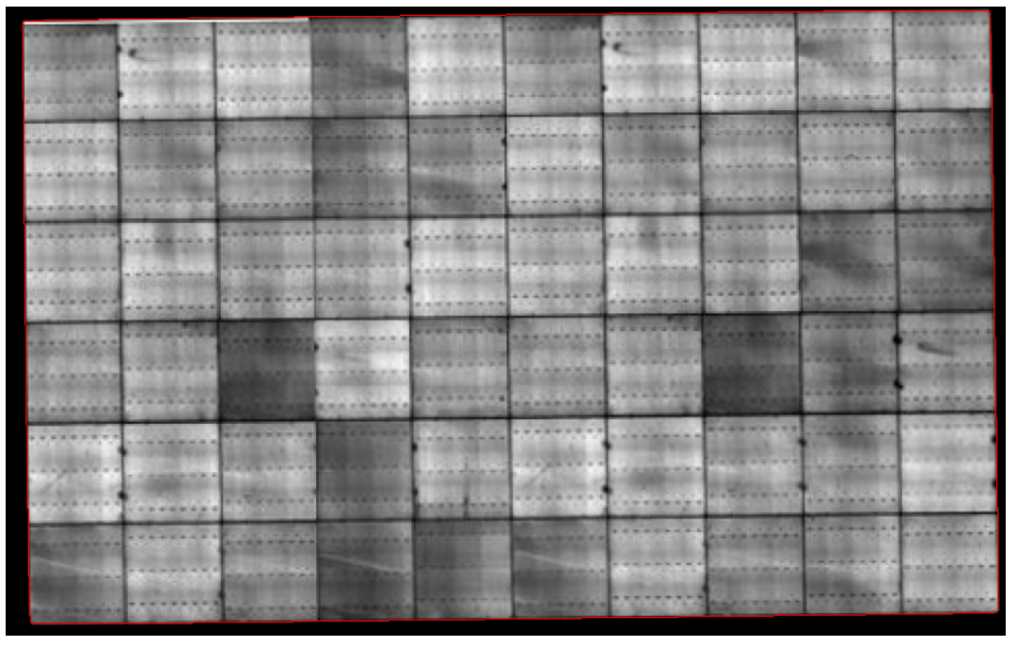
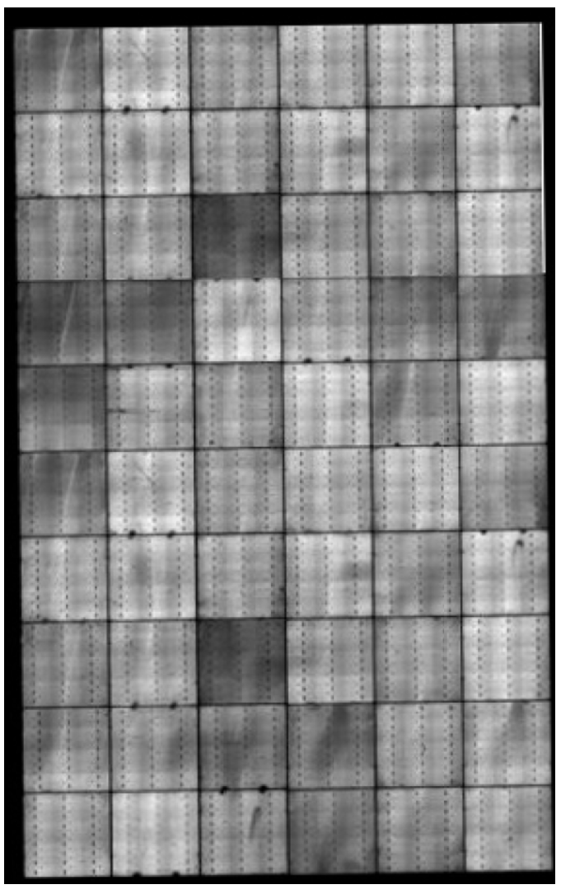
EL Image Processing Enhanced version with Adaptive Learning and Interpolation
Raw Image
Rotate, Grayscale and Warp Background

Slide 4
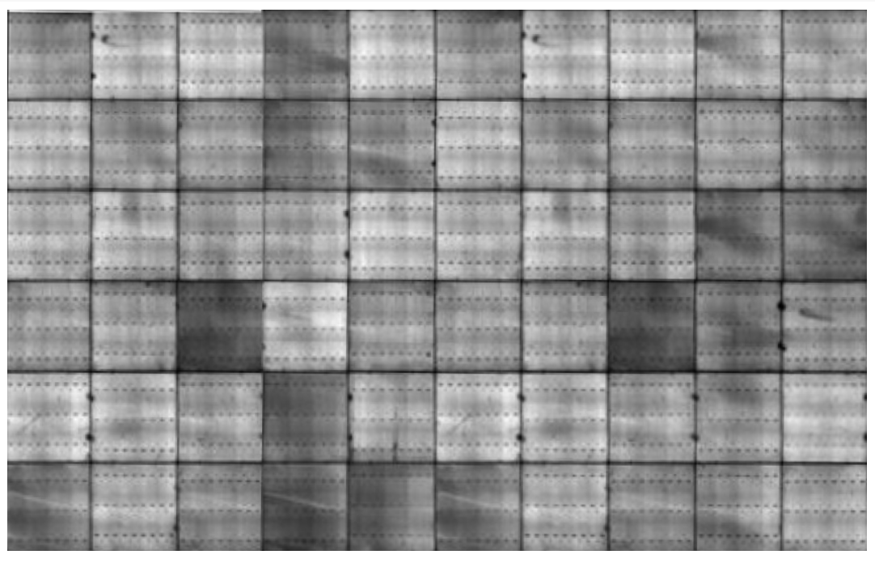
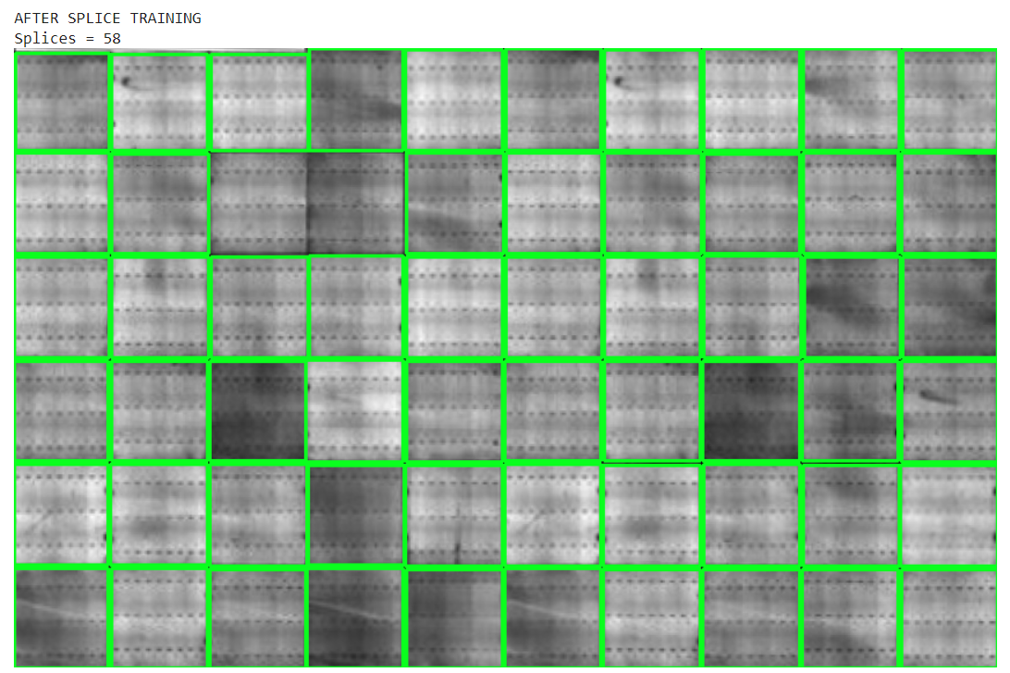
EL Image Processing Enhanced version with Adaptive Learning and Interpolation
Adaptive Cell Splicing
-> Optimize Blur Algorithm
-> Optimize Edge Detection Threshold
Flatten

Slide 5
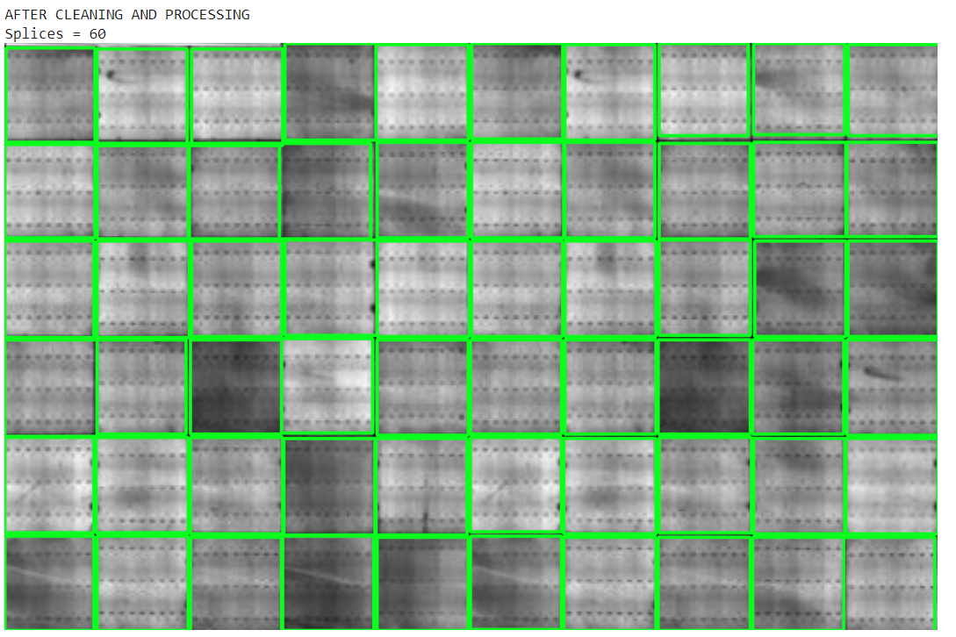
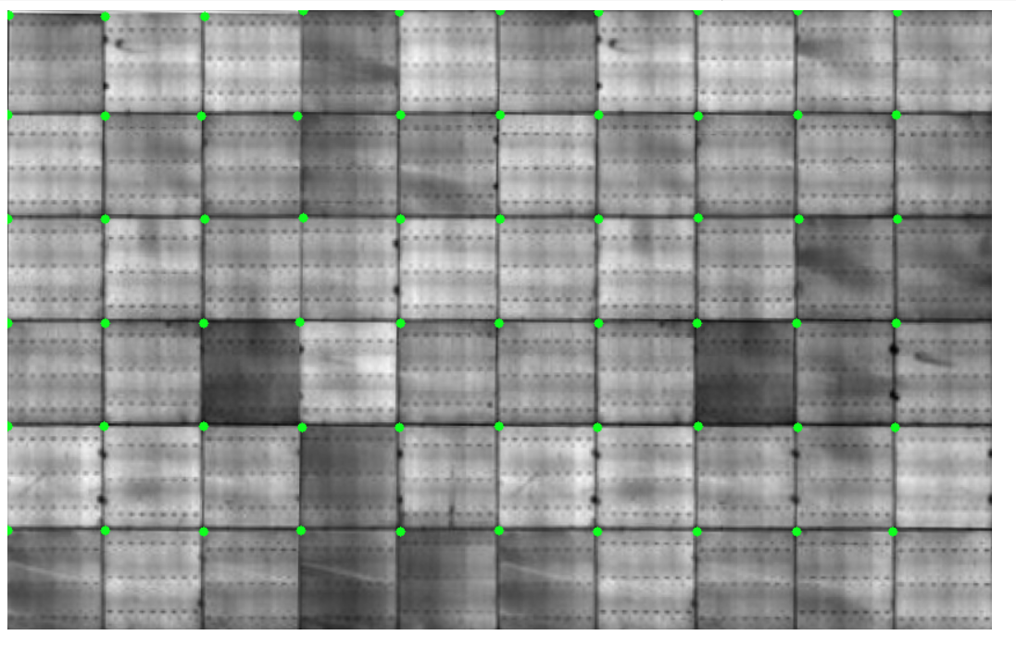
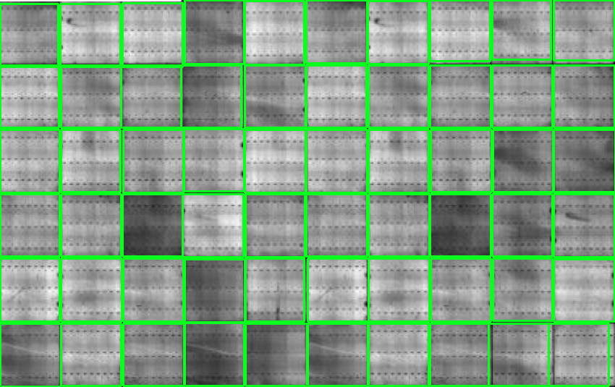
EL Image Processing Enhanced version with Adaptive Learning and Interpolation
Interpolate Corners
Splice Interpolation

Slide 6
02
User Guide (For running local)

Slide 7
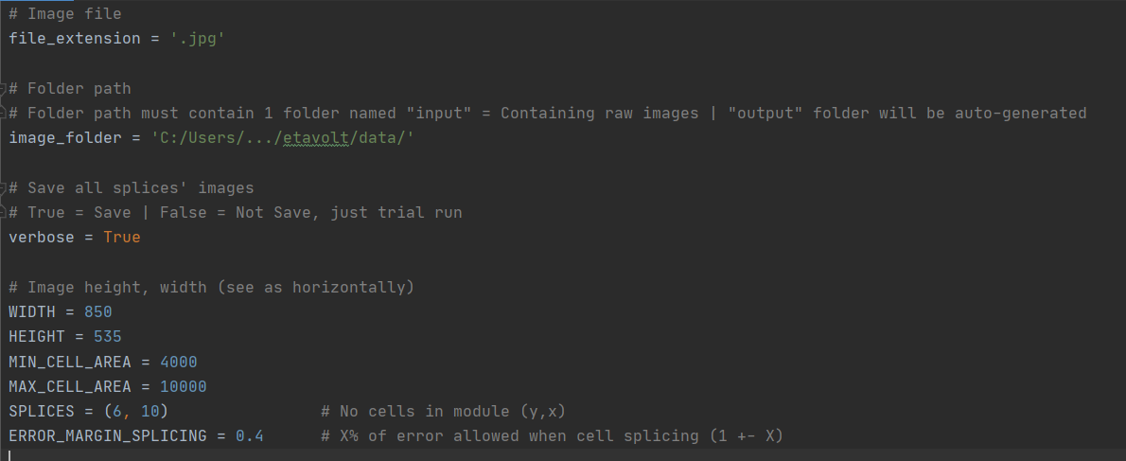
Step 1
User’s Configurations
Specify the parameters in UserInput.py
The important ones are:
image_folder path, WIDTH and HEIGHT of output image, and SPLICES

Slide 8

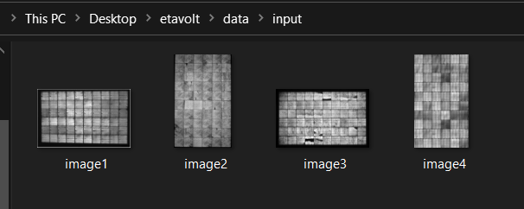
Step 2
Raw images in image_folder path
Create the image_folder path as specified in UserInput.py
Drop the raw images in ./input/

Slide 9
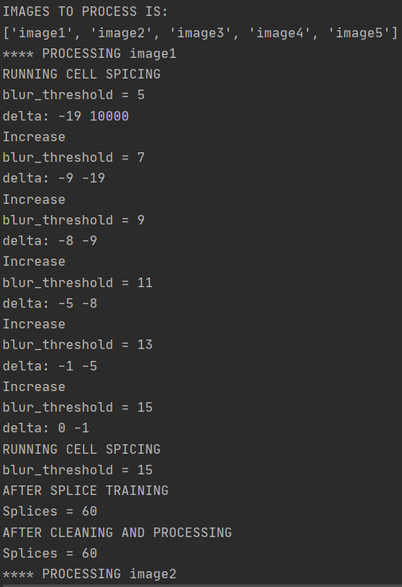
Step 3
Execute ELprocessing.py
Execute >> python ELprocessing.py
The program will automatically generate the respective raw images

Slide 10
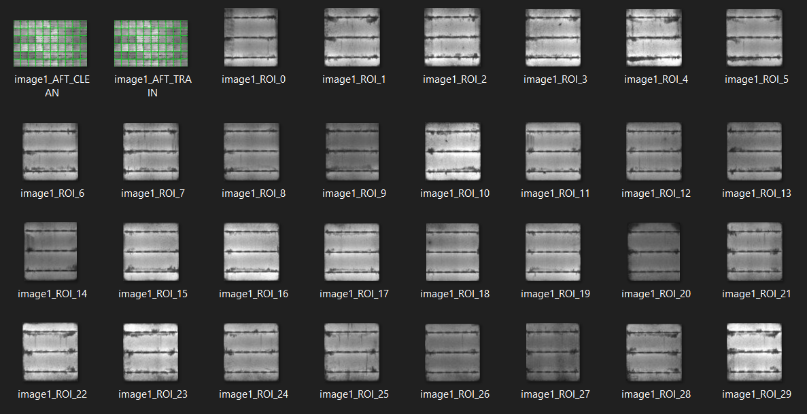
Step 4
Obtain Results
Output images are auto-generated in ./output/ folder
Images are saved only when verbose = True (in UserInput.py)

